Slide 1

MIPS Project Overview
Module Responsibilities and Workflow
Chazon Mingarine, Bryce Gill, Micah Thompson , Tatenda Machirori ,Summit Singh .

Slide 2
Core Data Structures & Utilities
Responsible for simulating the core hardware: registers, memory, and ALU.
Provides helper utilities for parsing and opcode conversion.
Acts as the foundation for the parser, pipeline logic, and debug/output modules.
Chazon M.

Slide 3
Data Structures Overview
My module implements the following components:
Register File (32 Regs)
Main memory
ALU
Utility Functions
Chazon M.

Slide 4
Register File
Simulates the actual 32 registers in MIPS hardware.
Key Features:
32 registers
Register 0 is always 0
Supports safe read() and write() operations
Chazon M.

Slide 5
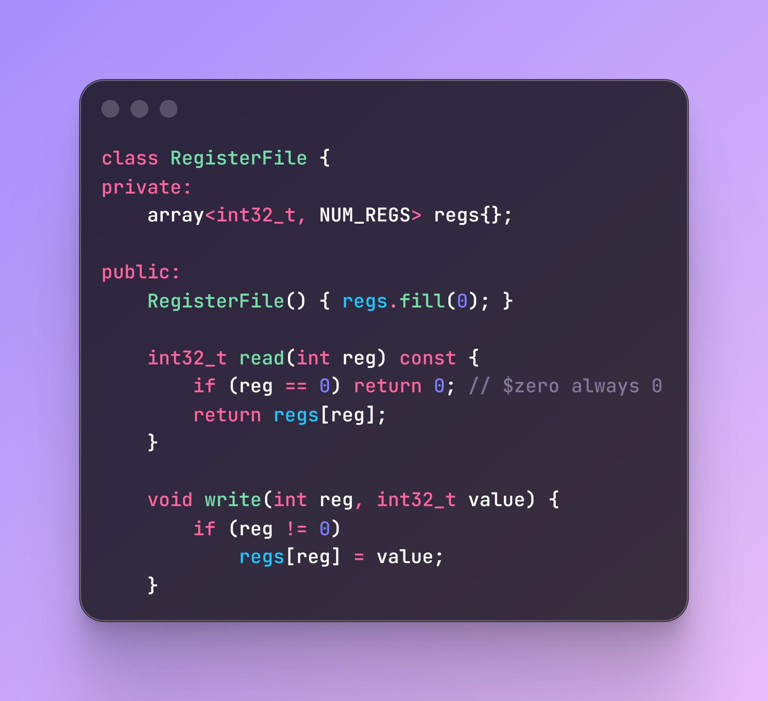
Register File
Represents the 32 MIPS registers (32-bit each).
Includes read/write operations.
Ensures $zero cannot be modified.
Chazon M.

Slide 6
Memory
Simulates word-addressable main memory for loads/stores
Key Features:
LoadWord() and StoreWord() operations
Bounds checking
Chazon M.

Slide 7
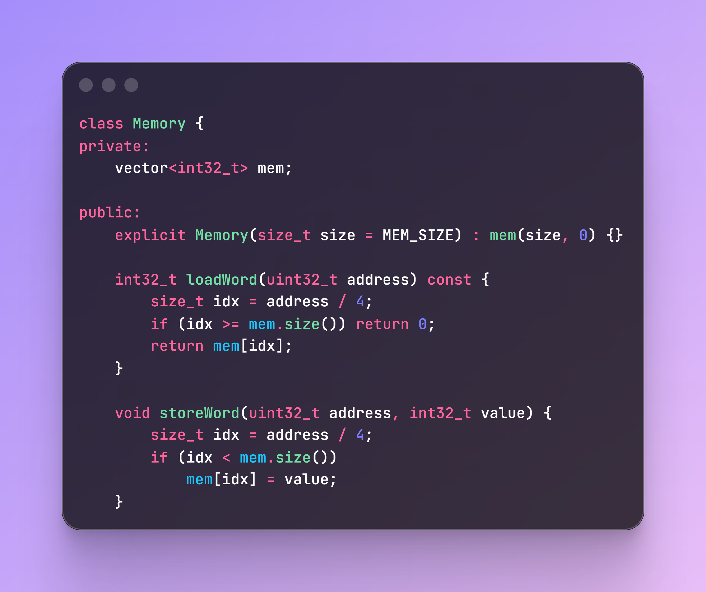
Memory
Creates dynamically resizable array of 32-bit words.
Constructor initializes all memory to 0. Allocates size words of memory.
Convert byte address to words. (Memory stores words)
Checks if index is valid.
Reads from mem if LOAD
Writes to mem if STORE
Chazon M.

Slide 8
ALU (Arithmetic Logic Unit)
Simulates the ALU in the EX stage
Supports:
ADD, ADDI, SUB
MUL
AND, OR
SLL, SRL
Comparison for BEQ (handled in pipeline logic)
Chazon M.

Slide 9
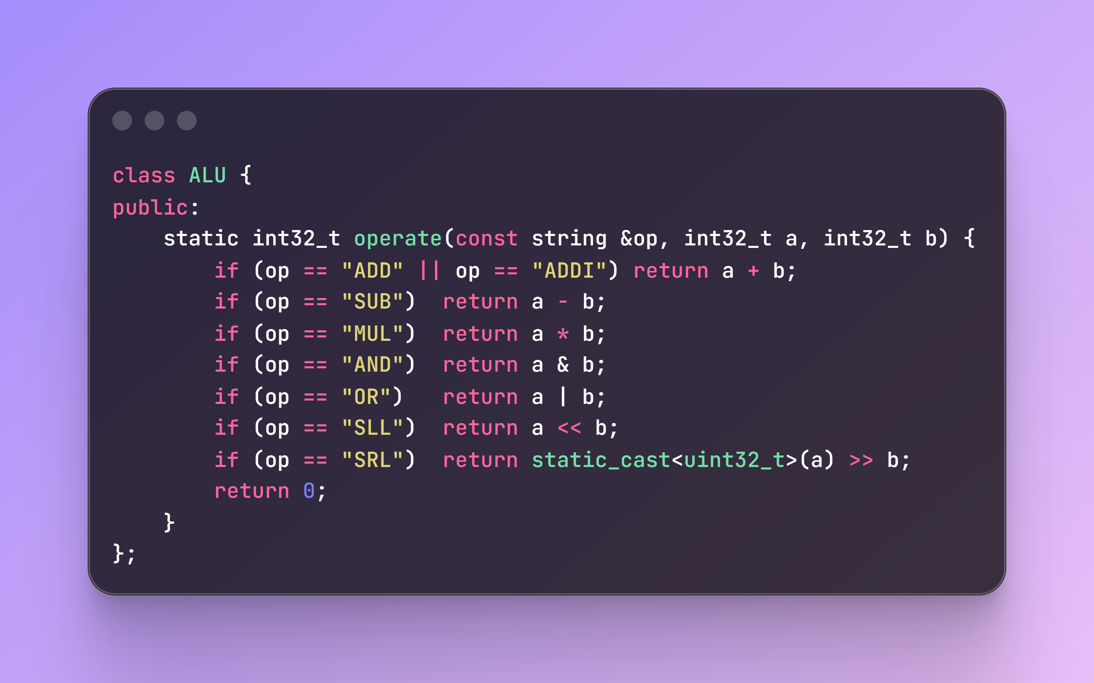
ALU (Arithmetic Logic Unit)
Static Cast to ensure it zero-fills. SRL defaults to sign extend for signed numbers. Casting to uint32_t forces logical behavior. SLL behaves identically for signed and unsigned types.
Chazon M.

Slide 10
Utility Functions
Trim(string)
Cleans assembly lines before parsing
StrToOpcode(string)
Converts "ADD" to Opcode::ADD (the Opcode enum value)
Chazon M.

Slide 11
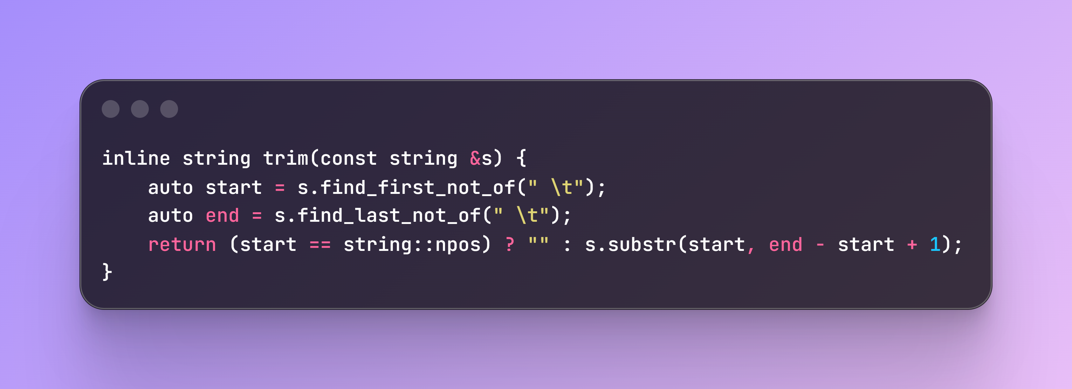
Utility Functions
Purpose: Removes leading and trailing whitespace (spaces or tabs) from a string.
Chazon M.

Slide 12
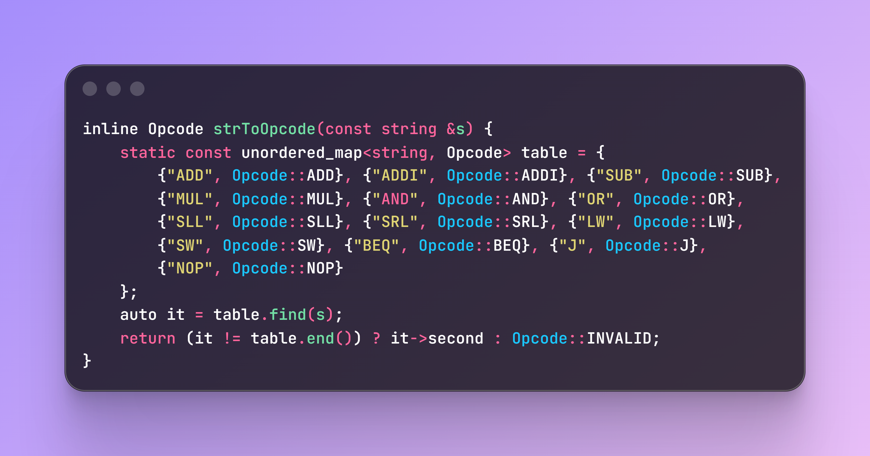
Utility Functions
Purpose: Converts a string representing A MIPS instruction (like "ADD") into the corresponding Opcode enum (Opcode::ADD). Searches the table to find the string passed. If the string exists in the table, returns the mapped enum value. If it doesn’t, return as invalid.
Chazon M.

Slide 13
Instruction Parser & Decoder
Reads MIPS assembly input
Extracts opcodes, registers, immediates
Connects decoded fields to core structures

Slide 14
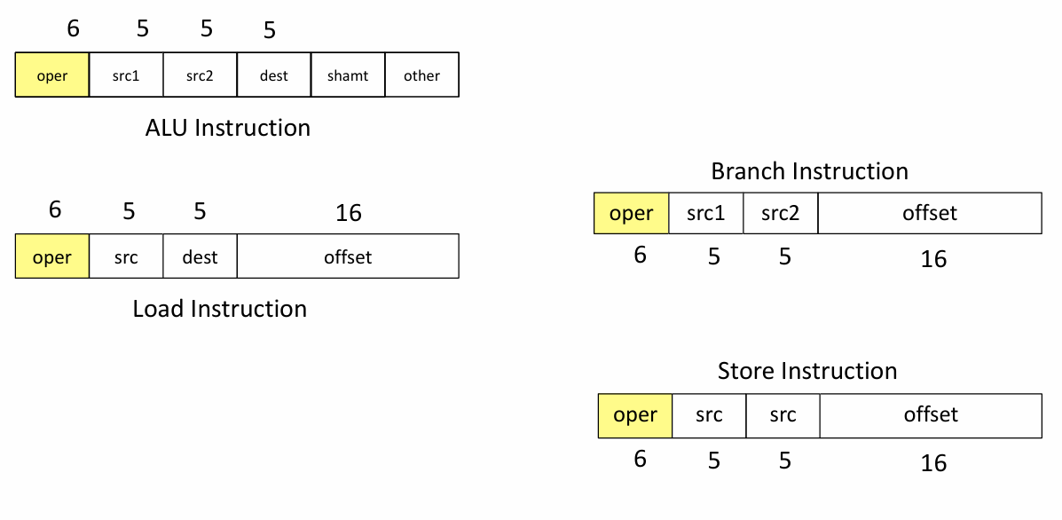
MIPS Instruction Format
R-TYPE: Used for ALU operations, where all operands are located in registers.
I-TYPE(Immediate): Used for operations involving a constant value, such as loads, stores, and arithmetic with immediates.
J-TYPE: Used for unconditional jumps, providing a large address range for transferring program control.
parser's primary job is to correctly identify and extract these specific fields from a raw 32-bit instruction

Slide 15
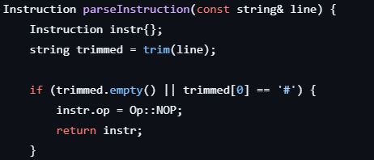
Cleaning The Input
Clean the Input:
string trimmed = trim(line); // Remove extra spaces
if (trimmed.empty() || trimmed[0] == '#') {
return NOP; // Ignore empty lines and comments
}
Example
- Input: ` ADD $10, $8, $9 # Add registers `
- After trim: `ADD $10, $8, $9`
- Comment part ignored

Slide 16
Extracting Instruction Name
Extract Instruction Name
iss >> token; // Get first word: "ADD"
transform(token.begin(), token.end(), token.begin(), ::toupper); // Convert to uppercase
opMap.find(token); // Look up in our instruction dictionary
```
Example:
- Token: `"ADD"` → Finds `Op::ADD` in our map
- Token: `"add"` → Converts to `"ADD"` first, then finds `Op::ADD`
- Unknown instruction? → Returns NOP and prints error
-----------
ADDI $8, $0, 10
ADD $10, $8, $9
HALT
Becomes Vector:
---------------
[Instruction{op=ADDI, rt=8, rs=0, imm=10},
Instruction{op=ADD, rd=10, rs=8, rt=9},
Instruction{op=HALT}]
```

Slide 17
Instruction Types
**R-type Instructions** (like ADD, SUB):
```
ADD $10, $8, $9
│ │ │ │
│ │ │ └─ Third register ($9)
│ │ └───── Second register ($8)
│ └────────── Destination register ($10)
└─────────────── Operation (ADD)
```
I-type Instructions** (like ADDI - Add Immediate):
```
ADDI $8, $0, 10
│ │ │ │
│ │ │ └─ Immediate value (10)
│ │ └───── Source register ($0)
│ └───────── Destination register ($8)
└─────────────── Operation (ADDI)
```
Memory Instructions** (like LW - Load Word):
```
LW $10, 4($8)
│ │ │ │ │
│ │ │ │ └─ Base register ($8)
│ │ │ └─── Closing parenthesis
│ │ └─────── Offset value (4)
│ └─────────── Destination register ($10)
└─────────────── Operation (LW)
```
**Parsing Process:**
1. Extract `$10` → Remove `$` → Store as `rd = 10`
2. Extract `$8` → Remove `$` → Store as `rs = 8`
3. Extract `$9` → Remove `$` → Store as `rt = 9`
**Parsing Challenge**: Need to split `"4($8)"` into:
- Offset: `4`
- Base register: `$8` → extract `8`
For each type, you must extract the operation and the appropriate registers or immediate values.
With memory instructions, special parsing is needed to separate the offset and base register so the instruction can be properly represented in your code.

Slide 18
Handling Flexible Input Format
Problem: Users might write:
- `ADD $10, $8, $9` (with commas)
- `ADD $10 $8 $9` (without commas)
Solution:
if (iss.peek() == ',') iss.ignore(); // If comma exists, skip it
iss >> reg1; // Read next register
```

Slide 19
Bug Fix
Challenge 1: Register Parsing Bug
The Problem:
WRONG - reuses same variable
string reg;
iss >> reg >> comma >> reg >> comma >> reg;
Each read overwrites previous value!
```
Example with `ADD $10, $8, $9`:
- First read: `reg = "$10"`
- Second read: `reg = "$8"` (overwrites $10!)
- Third read: `reg = "$9"` (overwrites $8!)
- Result: All registers become $9 ❌
The Solution:
CORRECT - separate variables
string reg1, reg2, reg3;
iss >> reg1 >> comma >> reg2 >> comma >> reg3;
Each register stored separately ✓

Slide 20
Pipeline Simulation Logic
Purpose of the File
Implements 5 pipeline stages (IF, ID, EX, MEM, WB)
Executes parsed instructions from mips_parser.cpp
Handles hazards, forwarding, stalling, branching, jumps, and register/memory updates
Pipeline Stages Implemented
IF – Instruction Fetch
ID – Instruction Decode / Register Read
EX – Execute / ALU
MEM – Memory access
WB – Write Back
Inputs/Outputs
Input: vector<Instruction> from parser (list of structured IR instructions) and memory size
Output: final register file, memory state, and optional trace output

Slide 21
Core Data Structures
Register Memory
WordMemory mem_;
Aligned, word-addressed, bounds-checked
Used for LW/SW
Register File
using RegFile = array<int32_t, 32>;
RegFile regs_; // $0-$31
$0 is protected (always reads as 0)
Pipeline Registers
Each stage keeps state:
IF/ID, ID/EX, EX/MEM, MEM/WB
Each stores:
The instruction
Control signals
Operand values
Intermediate results

Slide 22
Pipeline Flow
1️⃣ IF Stage
Fetch instruction: prog_[pc/4]
Increment PC
Detect branch flushes / stalls before advancing IF/ID
2️⃣ ID Stage
Decode opcode → generate Control
Read registers (with $0 protection)
Handle:
Jump address formatting
Branch immediate sign-extension
Hazard detection for load-use → Inserts a bubble (stall)
3️⃣ EX Stage
ALU executes operation:
ADD, SUB, SLT, LW/SW address, Branch compare
Extended: MUL, SLL, SRL
Forwarding logic chooses correct operands
Branch target computed and flush applied if taken
4️⃣ MEM Stage
LW → reads mem_.load_word()
SW → writes mem_.store_word()
5️⃣ WB Stage
Writes ALU result or memory data into regs_
Except $0, which is never written

Slide 23
Hazard Handling & Fixes Implemented
Branching & Jumping
Immediate sign-extended in EX
Jump target fixed:
Address shifted exactly once
Upper PC bits preserved
Other Key Fixes (after debugging)
Register $0 read returns 0
Correct initialization order in constructor
Fixed immediate sign-extension for ALU & branches
Added support for:
MUL
SLL (SL)
SRL
L (treated as LW)
Hazard Detection
Load-use hazard (critical fix)
uint8_t load_dest = id_ex_.rt; // LW always writes to rt if (load_dest == if_id_.instr.rs || load_dest == if_id_.instr.rt) stall = true;
Causes pipeline stall + bubble insertion
Forwarding
From EX/MEM → ALU
From MEM/WB → ALU
Prevents unnecessary stalls

Slide 24

Output & Debug Modules
Output & Debug Modules
OutputManager Class
Summary: Handles all formatted output, as well as debugging for MIPS simulator
Components:
Register Display System
All 32 MIPS registers ($0-$31)
Register names (zero, at, v0, v1, a0-a3, t0-t9, s0-s7, gp, sp, fp, ra)
Dual format: Decimal + Hexadecimal
Memory Visualization
Displays memory contents (256 bytes)
Word-aligned formatting (4 bytes per word)
Address range: 0x00000000 - 0x000000FF
Debug Mode
Toggle on/off capability
Per-cycle instruction tracking
Pipeline state monitoring

Slide 25
Generates Final Register and Memory Output
Complete register file (32 registers)
Format: Name, Decimal, Hexadecimal
Example:
$0 zero 0 0x00000000 $8 t0 42 0x0000002a
Memory: First 256 bytes in 16-byte rows
Prints Pipeline State Per Instruction
5 Pipeline Stages: IF → ID → EX → MEM → WB
Per-stage information:
Current instruction
Program Counter (PC)
Stage status (Active/Idle/Stalled)
Cycle-by-cycle tracking
Optional UI or Command-Line Formatting
Professional formatting:
Section headers with separators (=== and ---).
Aligned columns with proper spacing
Clean table structures
Flexible output:
Debug mode: Verbose per-cycle details
Normal mode: Final state only
Control signal display:
RegDst, ALUSrc, MemtoReg, RegWrite
MemRead, MemWrite, Branch, ALUOp

Slide 26

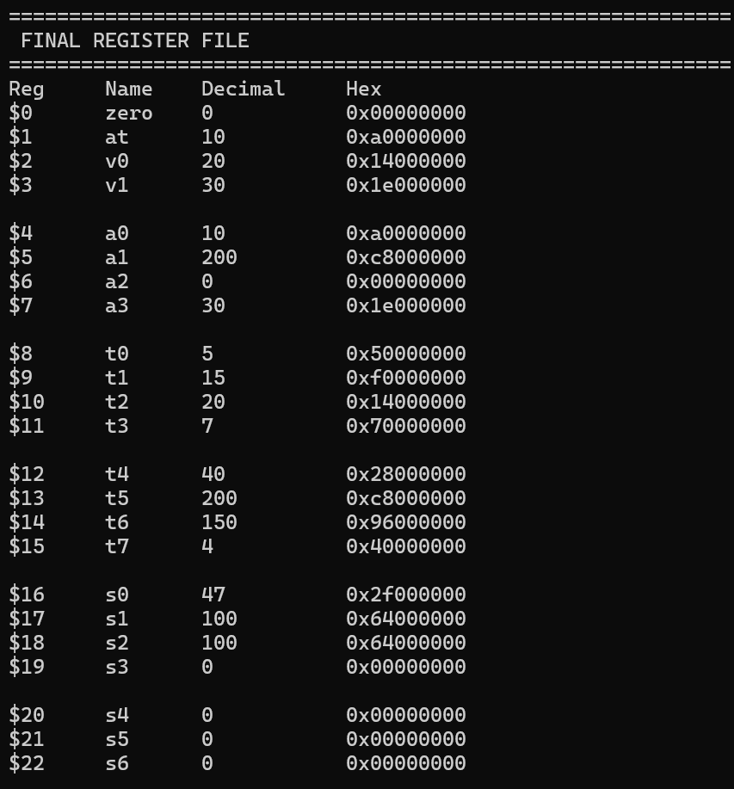
OUR OUTPUT IN CAPI

Slide 27
mips_ir.hpp - Defining the Instruction Format
What operation to perform (ADD, SUBTRACT, etc.)
Which registers to use (like variables: $8, $9, $10)
What values to work with (numbers, addresses)
enum class Op {
ADD, ADDI, SUB, MUL, // Math operations
AND, OR, // Logic operations
SLL, SRL, // Shift operations
LW, SW, // Memory operations
BEQ, J, // Control flow
HALT, NOP // Control
};
Why use an enum?
Type-safe: Can't accidentally use "ADDD" instead of "ADD"
Fast lookup: Computer can quickly identify instruction type

Slide 28
struct IRInstruction {
Op op; // What operation? (ADD, SUB, etc.)
uint8_t rs; // First source register (e.g., $8)
uint8_t rt; // Second source register (e.g., $9)
uint8_t rd; // Destination register (where result goes, e.g., $10)
uint8_t shamt; // Shift amount (for shift instructions)
int32_t imm; // Immediate value (a number like 10)
uint32_t addr; // Jump address (for jump instructions)
std::string raw_label; // Branch label name
};
Real Example:
Assembly: `ADD $10, $8, $9`
Becomes: `op=ADD, rs=8, rt=9, rd=10`
Why this design?
Unified structure: One format works for all instruction types
Easy to pass around: Pipeline can access any field it needs
Extensible: Easy to add new instruction types later

Slide 29
Main
the `main()` function orchestrates the entire program. It coordinates input handling, parsing all instructions, running the simulator, and displaying results. Step 1: parseInstruction() is called and a vector is made of the instructions
Input File:
-----------
ADDI $8, $0, 10
ADD $10, $8, $9
HALT
Becomes Vector:
---------------
[Instruction{op=ADDI, rt=8, rs=0, imm=10},
Instruction{op=ADD, rd=10, rs=8, rt=9},
Instruction{op=HALT}]

Slide 30
Step 3: Execute Simulation (Lines 152-153 in main.cpp)
MIPSPipeline pipeline(program, 1 << 16, false);
pipeline.run(); // Run the pipeline simulator
- Creates pipeline with parsed instructions
- Runs simulation
- Pipeline processes all instructions through 5 stages
Step 4: Display Results (Lines 155-158 in main.cpp)
output.printFinalState(pipeline.regs_, pipeline.mem_);
cout << "Simulation completed in " << pipeline.cycles() << " cycles.\n";
Shows final register values, memory contents, and performance metrics

Slide 31
Bug 2
Shift Instructions Need Special Handling
The Problem:
Most instructions: Immediate value goes in `imm` field
Shift instructions (SLL/SRL): Shift amount goes in `shamt` field
Example:
ADDI $8, $0, 10` → stores `10` in `imm` field
SLL $10, $8, 2` → stores `2` in `shamt` field (not `imm`!)
The Solution:
case Op::SLL: case Op::SRL: {
int shamt_val; // Read as integer first
iss >> shamt_val;
instr.shamt = static_cast<uint8_t>(shamt_val); // Store in shamt field
break;
}
Why read as int first?
Reading directly into `uint8_t` reads ASCII value ('2' = 50) instead of number (2)
Reading as `int` then converting fixes this

Slide 32

THANK YOU

